Slide 1
What Could Make me Miss the Mark?

Slide 2
REVELATION 3 : 14 - 21
. . . Overcome! . . .

Slide 3
PHILIPIANS 3 : 13 - 14
. . . the prize . . .

Slide 4
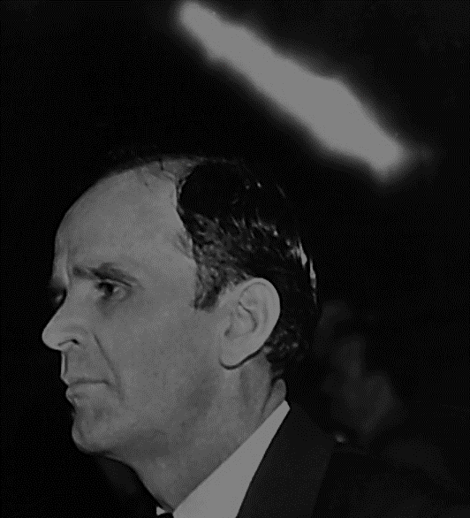
63-0825M How Can I Overcome?
44 We see this age that we’re living in. It’s one of the grandest ages of all ages. This Laodicea Church Age is the grandest of all the church ages, because it’s the ending of time and the blending of Eternity.

Slide 5
63-0825M How Can I Overcome?
… And, then, it’s the greatest sinful age. It’s more sin in this age than there’s ever been. And the powers of Satan is many times harder to fight against than it was in any age. See?

Slide 6
REVELATION 1 : 8
. . . Alpha and omega . . .

Slide 7
63-0825M How Can I Overcome?
43 So, if we are trying to follow the Message of the hour, or at least this part of the Message, we should live constantly in the Life of Christ. See? Cause, if it don’t, you lay around, and know that these things that you’re supposed to do, and don’t do it, …

Slide 8
63-0825M How Can I Overcome?
… the Bible said, “He that knoweth to do good, and doeth it not, to him it’s sin.” Then you become doty, rotten, when you’re separated from the Life of God. So, strive with all that’s in you, to stay in the Life of Christ, that you would be fruit-bearing.

Slide 9
How many of the things Bro Branham did have we considered just “his gift”?

Slide 10
How many of those things that he did were examples for us?

Slide 11
How many of those things that he did were examples for us?

Slide 12
- Grizzly Bear - Dawson Riley - Puppy ran over - How many prayers answered?

Slide 13
“Only believe… ALL things are possible”?

Slide 14
Spirit of Finishing

